Slide 1


Airline Ticket Reissue
COSC 498 – Capstone
Donna Dearing
Notes:
Hello, I’m Donna Dearing, and my Capstone Project is about Airline Ticket Reissue.

Slide 2

Introduction
This project concerns a solution for printing unnecessary ticket stock when an airline ticket must be reissued.
When an American Airlines (AA) passenger changes their ticket, whether voluntary or involuntary, the AA Agent must reissue the original ticket to reflect the change.
Otherwise, the passenger will not be able to check-in for that flight to obtain their boarding pass.
Only an AA Agent can reissue an airline ticket; passenger cannot reissue their ticket.
Notes:
Let me explain. When an AA psgr chgs their itin, whether vol or involuntary, the agent must reissue the tkt, otherwise the psgr cannot ck-in and obtain their boarding pass. Only and Agent can reissue, not a psgr.

Slide 3
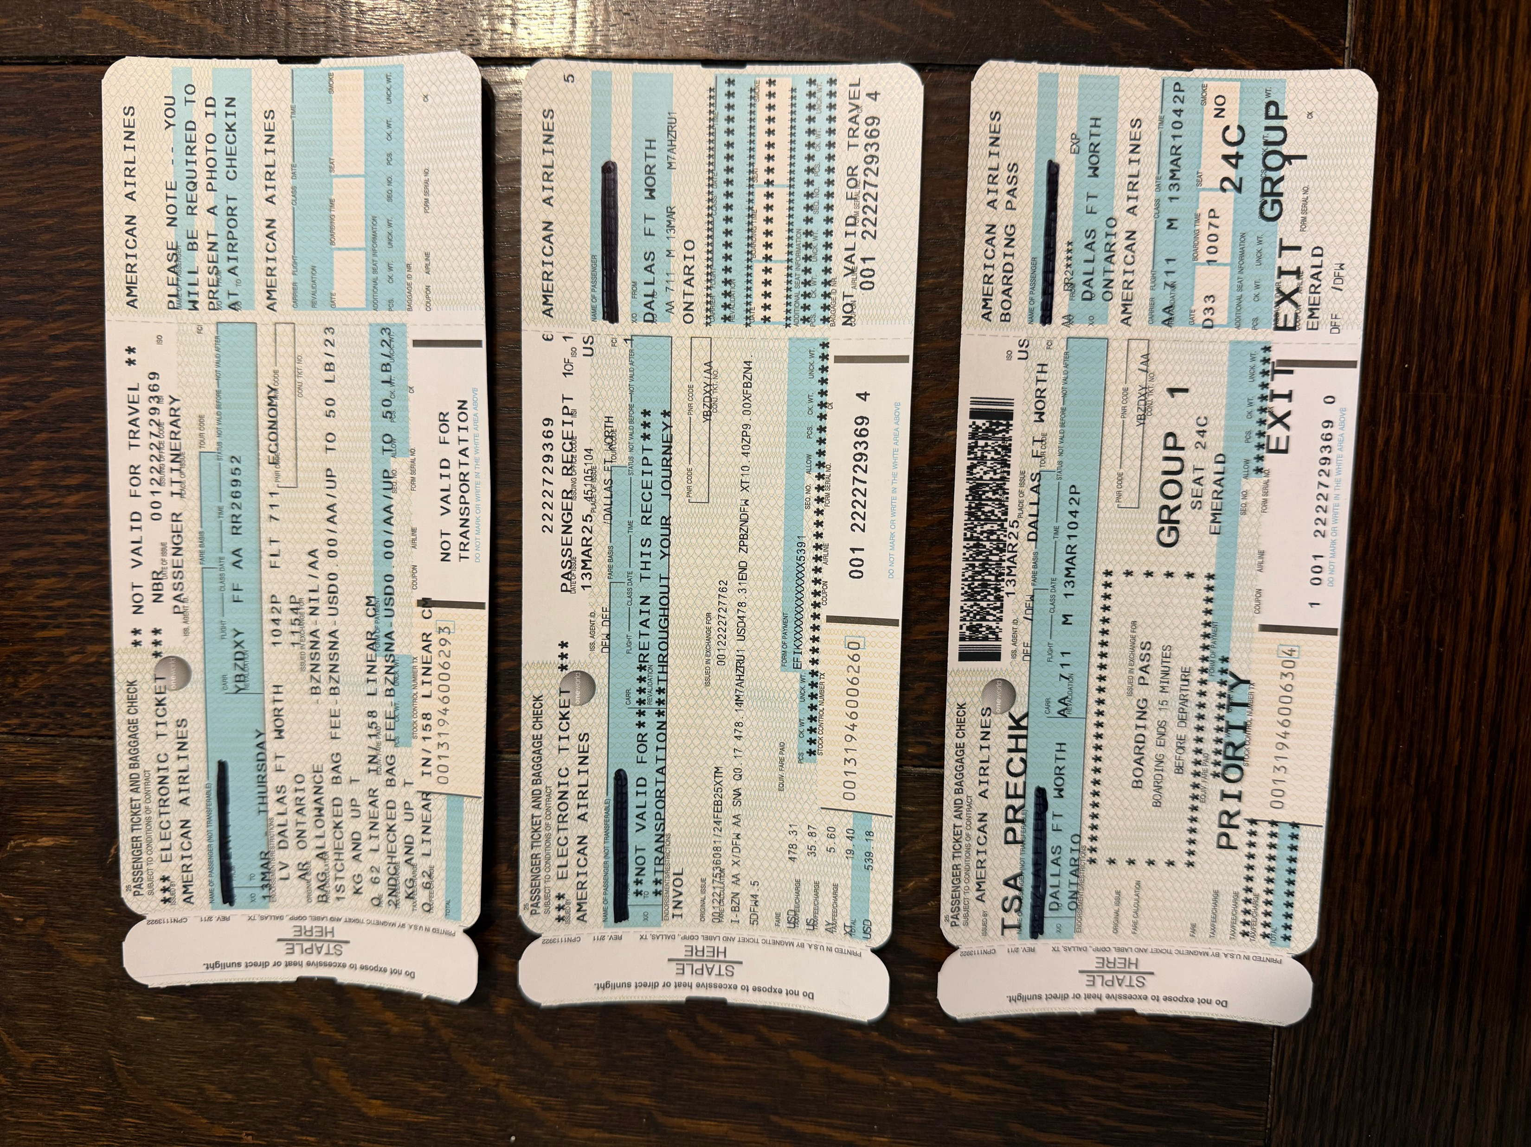
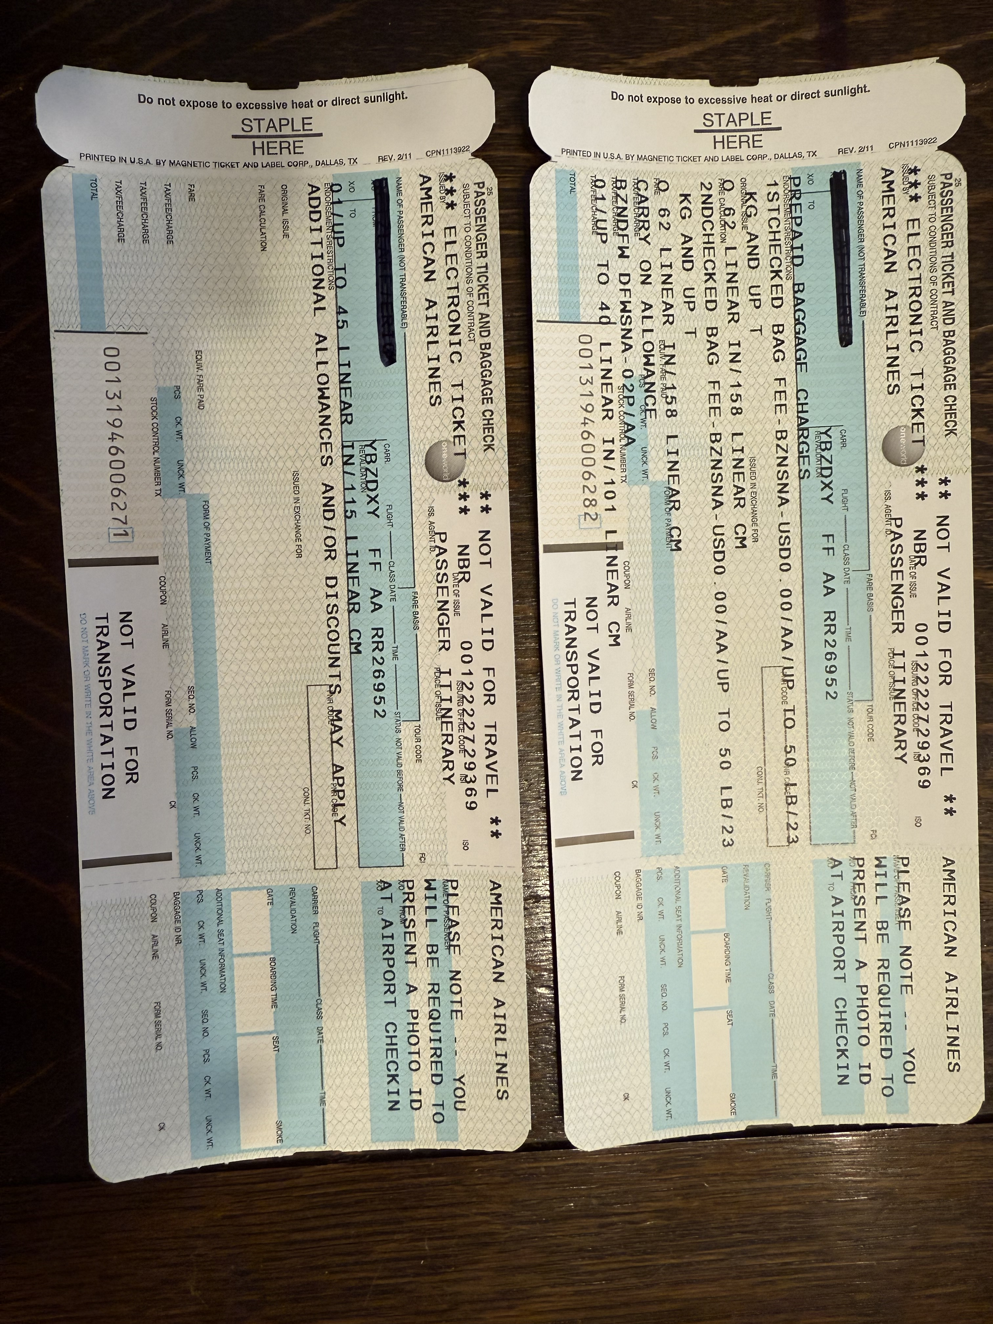
Unneeded Ticket Stock
#1-Itinerary, #2-Fare Info, #3-Boarding Pass
Notes:
On the left side we have a copy of the passenger’s itinerary, the fare information and the boarding pass, which is all we need. On the right side we have print outs that are not needed, such as baggage rules.

Slide 4
User Persona
During irregular operations (IROPS), where flights are delayed or canceled, a ticket sometimes must be reissued if the passenger must change their flight.
User Problem-Solving
Current programming must be changed to eliminate the coding that prints the unneeded ticket stock items.
This change would save ticket stock costs because fewer pages would be printed. Ticket stock costs $20.57 per box, and just in DFW alone, AA Agents use over 200 boxes per day approximately. This implementation will reduce ticket stock usage, thus reducing costs. Plus save passengers and agents time waiting for the extra pages to print out.
User Interaction
Saving passengers' time, the agent's time, and the company's money would justify this implementation.
Notes:
The User Persona is: User Problem-Solving involves changing or eliminating the code to not print out unnecessary items after the ticket exchange. This can save a min of over $4k per day in just one station alone. User Interaction will be saving the psgrs time, the agents time and the company’s money clearly justifies this implementation.

Slide 5
Solution To Reduce Ticket Stock
Create a database using MySQL to store airline reissue tables, such as:
Reservation details
Flight information
Passenger data
Use Visual Studio as a source code editor for intelligent code completion, snippets, code refactoring, and embedded version control with GitHub.
Use GitHub as a repository to store, share, and write code with others if necessary, to showcase, track and manage changes to any code over time.
Notes:
To reduce ticket stock, I've created a database using MySQL to store relavant tables, utilizing both Visual Studio code editor and GitHub repository to manage all code changes.

Slide 6
MySQL: final_airline_reissue code
DROP TABLE IF EXISTS Reservations;
DROP TABLE IF EXISTS Flights;
DROP TABLE IF EXISTS Passengers;
-- STEP 2: Create Passengers table
CREATE TABLE Passengers (
passenger_id INT AUTO_INCREMENT PRIMARY KEY,
record_locator VARCHAR(10),
name VARCHAR(255)
);
-- STEP 3: Create Flights table
CREATE TABLE Flights (
flight_id INT AUTO_INCREMENT PRIMARY KEY,
flight_number VARCHAR(10),
date_of_flight DATE,
departure_time TIME,
arrival_time TIME,
class_of_service VARCHAR(50),
origin_city VARCHAR(255),
destination_city VARCHAR(255),
CONSTRAINT flight_number_format CHECK (flight_number REGEXP '^[A-Z]{2}[0-9]{1,4}$')
);
-- STEP 4: Create Reservations table
CREATE TABLE Reservations (
reservation_id INT AUTO_INCREMENT PRIMARY KEY,
passenger_id INT,
flight_id INT,
ticket_status ENUM('booked', 'reissued', 'canceled'),
FOREIGN KEY (passenger_id) REFERENCES Passengers(passenger_id),
FOREIGN KEY (flight_id) REFERENCES Flights(flight_id)
);
-- STEP 5: Insert sample passengers
INSERT INTO Passengers (record_locator, name)
VALUES
('QHQGVB', 'Chester Drawers'),
('EOAGKF', 'Snap Crackle Pop'),
('MZUSQY', 'Bud Weiser’);
-- STEP 6: Insert sample flights
INSERT INTO Flights (flight_number, date_of_flight, departure_time, arrival_time, class_of_service, origin_city, destination_city)
VALUES
('AA2469', '2025-04-15', '07:00:00', '10:20:00', 'Economy', 'New York JFK', 'Los Angeles'),
('AA890', '2025-04-16', '14:00:00', '17:00:00', 'Economy', 'Chicago', 'Miami'),
('AA348', '2025-04-16', '21:00:00', '22:27:00', 'Economy', 'Dallas Fort Worth', 'Santa Ana'),
('AA36', '2025-04-22', '18:10:00', '13:50:00', 'Business', 'Dallas Fort Worth', 'Madrid');
-- STEP 7: View flight_id for mapping
-- You can run this SELECT manually in your SQL editor to get actual flight_id values:
-- SELECT flight_id, flight_number FROM Flights;
-- STEP 8: Insert reservations (assuming flight_ids are 1 to 4)
INSERT INTO Reservations (passenger_id, flight_id, ticket_status)
VALUES
(1, 1, 'booked'),
(2, 3, 'reissued'),
(3, 4, 'canceled');
Notes:
Here I'm displaying the code in the final_airline_reissue code to show how I created the tables.

Slide 7
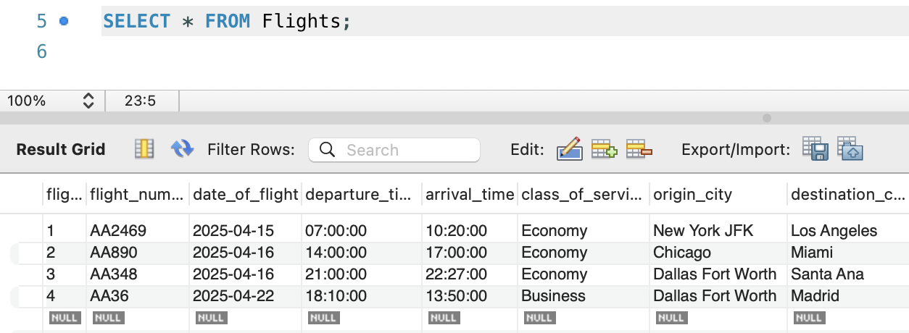
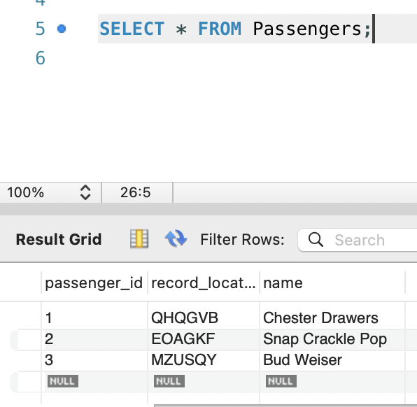
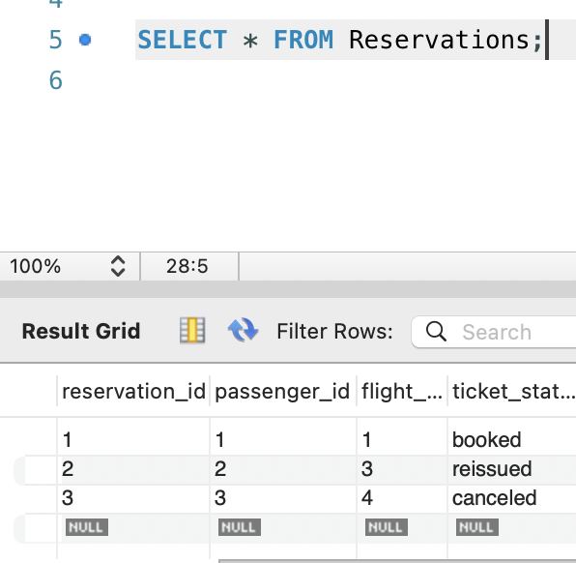
Output of Tables Created (final_airline_reissues.sql)
Notes:
This slide shows the output of each table created in the SQL file. Notice the Flight data display details, the Passengers data display w/record locator & names, and the Resv status display of booked/reissued or canceled.

Slide 8
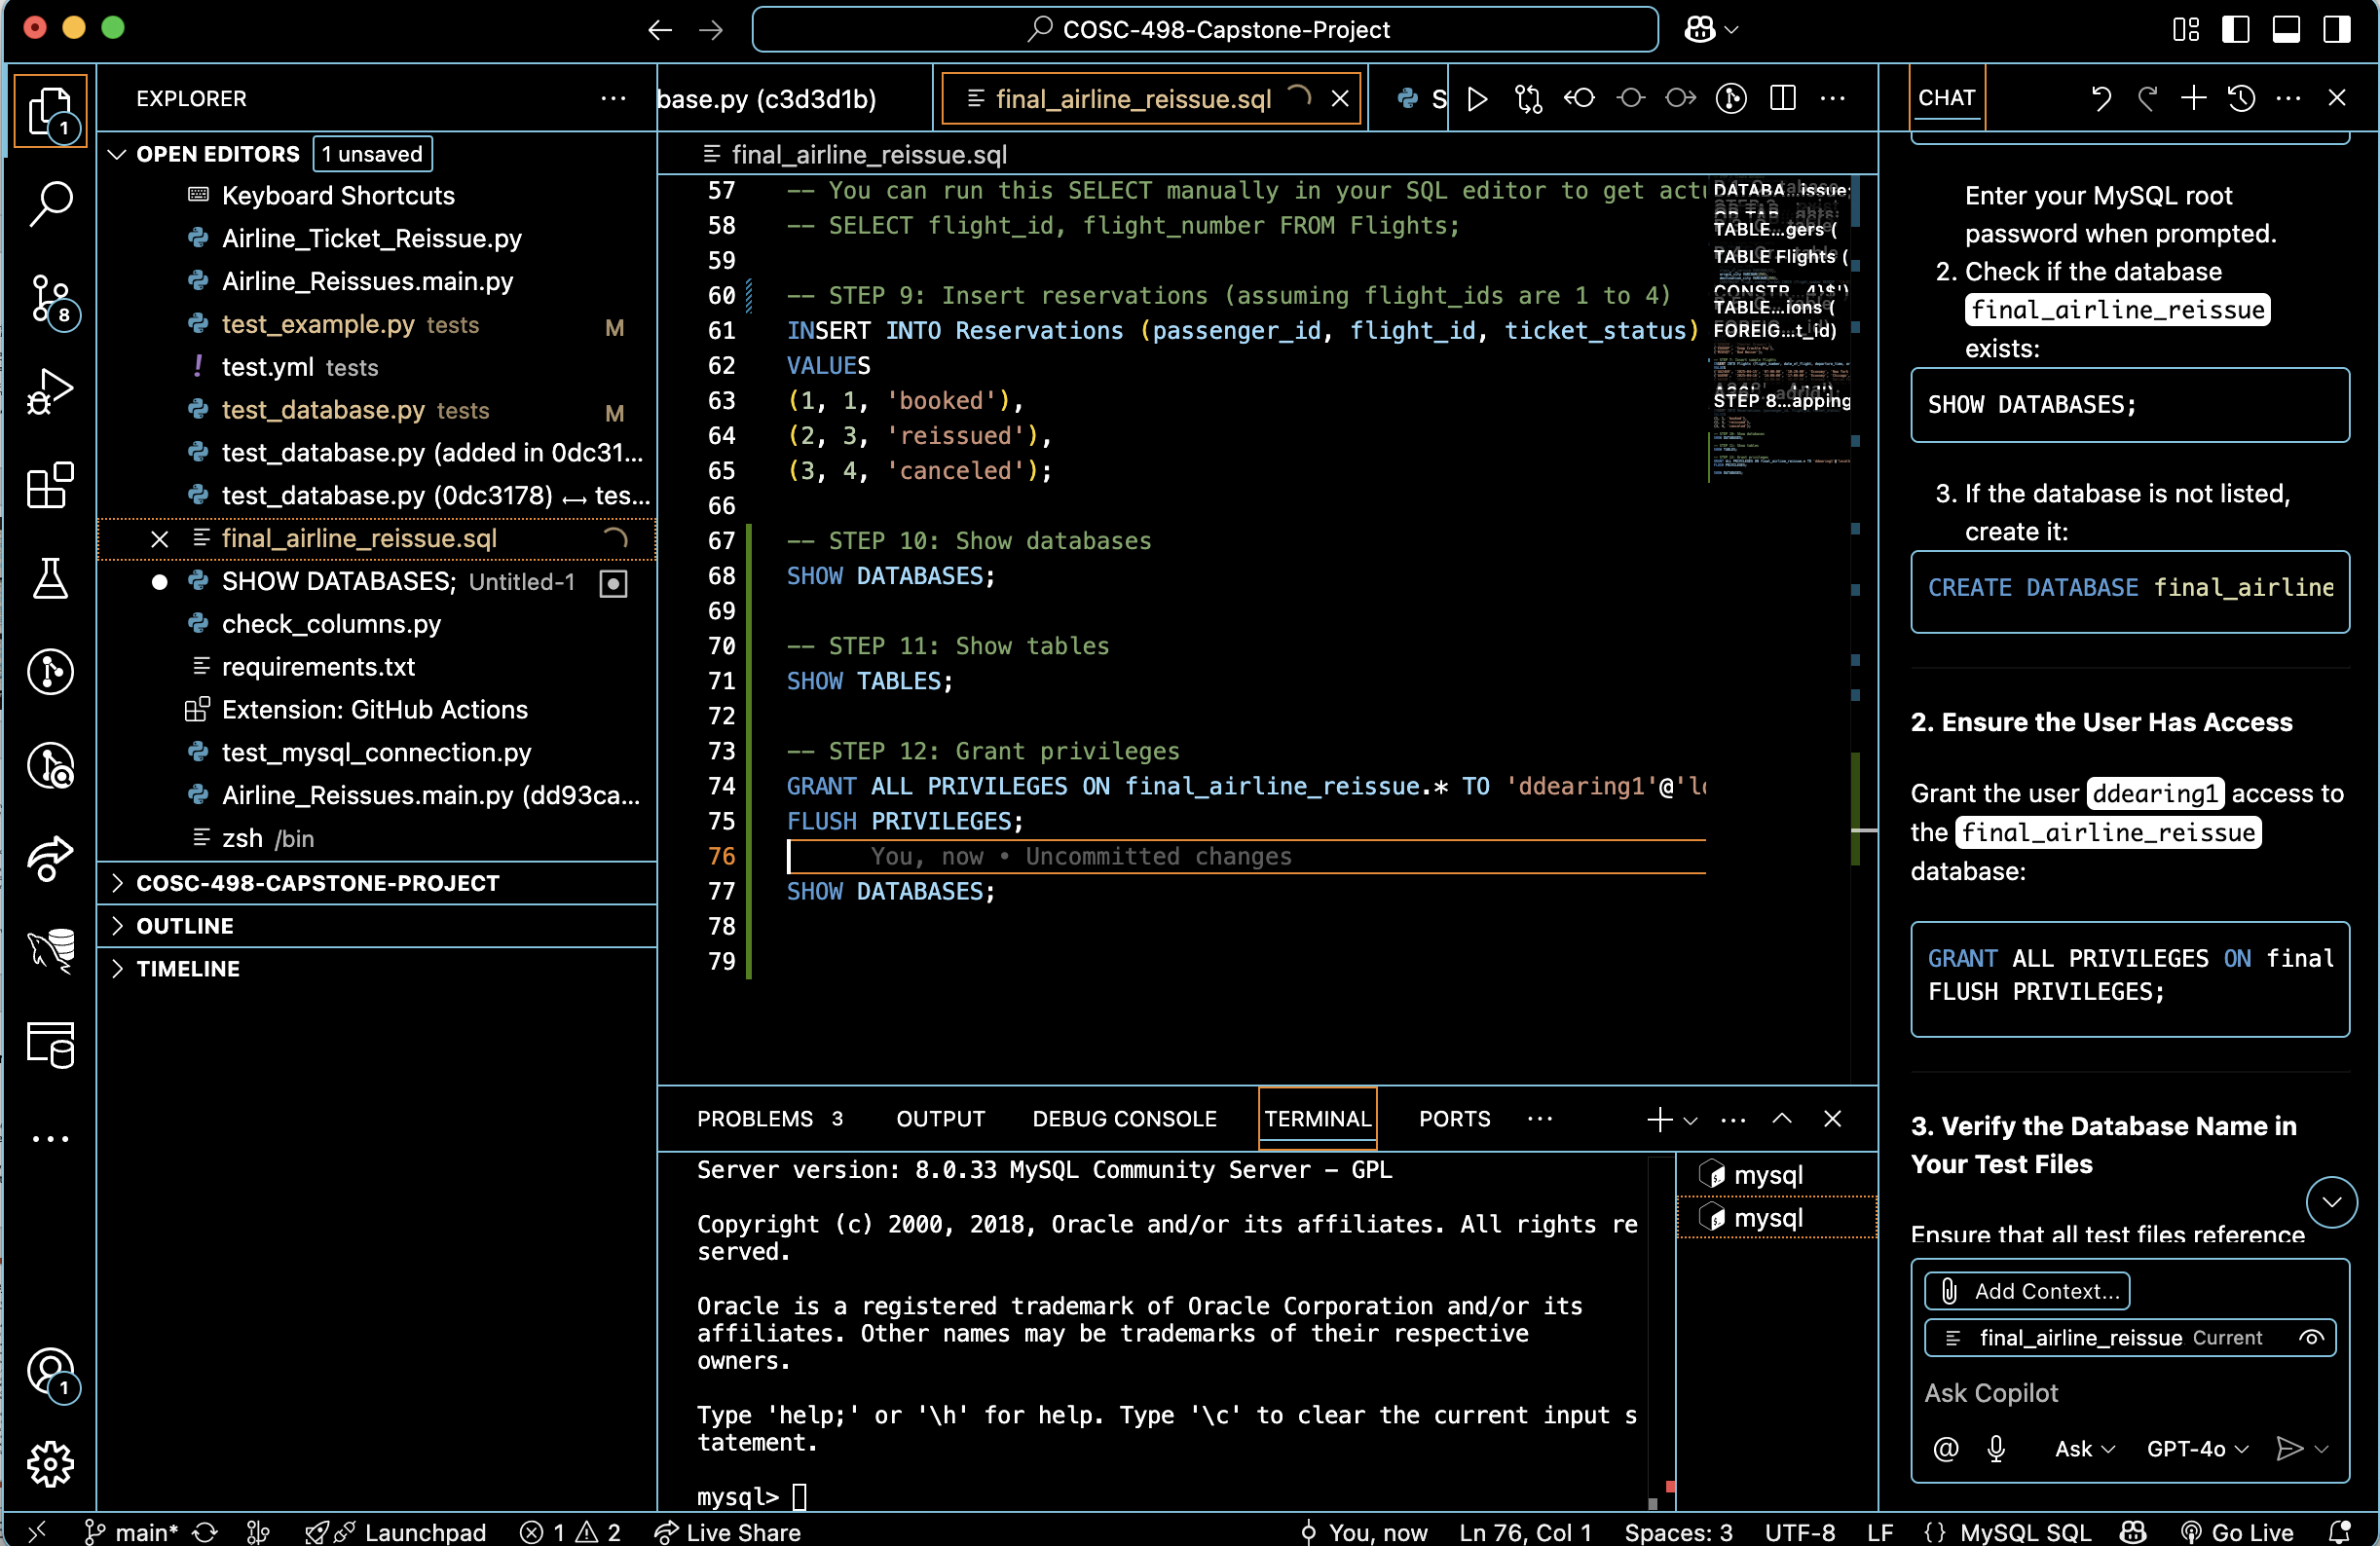
Visual Studio IDE – On my local harddrive
Notes:
This is a display of my Visual Studio IDE on my local hard drive where I can set up the code to communicate between MySQL files and GitHub, where my online repository is.

Slide 9
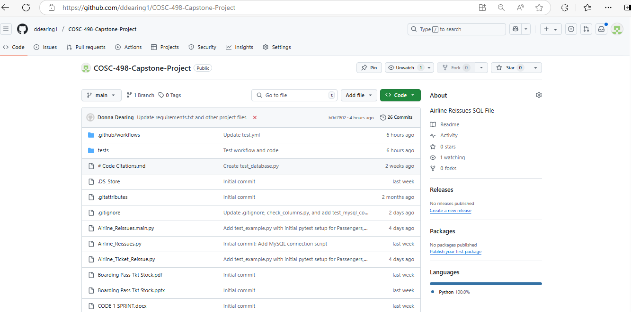
GitHub Link - ddearing1/COSC-498-Capstone-Project: Airline Reissues SQL File
Notes:
This slide shows the online link to my GitHub repository and all the files I've uploaded from Visual Studio to test my code.

Slide 10
Conclusion
Success in reducing costs for ticket stock and time for both the passenger and agent by:
Setting up a MySQL Database with proper tables to access the "Reservation", "Flights", and "Passenger" data,
Utilizing Visual Studio to communicate with MySQL and GitHub to ensure coding is properly executed,
Utilizing GitHub as a repository to store, share, and write code with other team members if necessary, to showcase, track, and manage changes to any code over time.
Notes:
In conclusion, the enhancement to printing only the necessary data when reissuing existing tickets when there are irregular operations with a flight, utilizing MySQL, VS & GitHub, saving time and money! Thank you for your time.

